Slide 1
Run-time storage management

Slide 2
Run-time storage management
We need to use memory to store:
code
static data (global variables)
dynamic data objects
data that are used when executing a certain procedure.
Dynamically allocated objects (malloc, free).

Slide 3
Run-time memory
Memory Layout
Code
Static data (Global variables)
Stack memory (for procedures)
Heap memory(Dynamic allocation)

Slide 4
Activation Record
also called frames
Information needed by a single execution of a procedure
A general activation record has seven fields

Slide 5
Activation record fields
Activation record
Return value
Actual parameters
Optional control link
Optional access link
Machine status
Local variables
Temporaries
Notes:
Optional control link- referring some location somewhere which is referring some other module.
Optional access link referring some other area of memory.
Machine status stores register state, values, PC etc of calling function.
Local variables & temporaries (t1, t2, ..) of called function.

Slide 6
Activation record fields…
Temporary values, such as those arising from the evaluation of expressions, in cases where those temporaries cannot be held in registers.
Local data belonging to the procedure whose activation record this is.
A saved machine status, with information about the state of the machine just before the call to the procedure. This information typically includes the return address (value of the program counter, to which the called procedure must return) and the contents of registers that were used by the calling procedure and that must be restored when the return occurs.
An “access link" may be needed to locate data needed by the called procedure but found elsewhere, e.g., in another activation record.
A control link, pointing to the activation record of the caller.

Slide 7
Activation record fields…
Space for the return value of the called function, if any. Again, not all called procedures return a value, and if one does, we may prefer to place that value in a register for efficiency.
The actual parameters used by the calling procedure. Commonly, these values are not placed in the activation record but rather in registers, when possible, for greater efficiency. However, we show a space for them to be completely general.

Slide 8
Storage – memory
Static allocation
Stack allocation
Heap allocation

Slide 9
Static allocation
Lays out storage for all data objects at compile time.
Constraints:
size of object must be known and alignment requirements must be known at compile time.
No recursion.
No dynamic data structure

Slide 10
Stack allocation
Stack allocation manages the run time storage as a stack
The activation record is pushed on as a function is entered.
The activation record is popped off as a function exits.
Constraints:
values of locals cannot be retained when an activation ends.
A called activation cannot outlive a caller.

Slide 11
Heap allocation
Heap allocation -- allocates and deallocates storage as needed at runtime from a data area called as heap.
Does not require the activation of procedures to be LIFO.
Requires true dynamic memory management.

Slide 12
Example
How is stack memory managed?
Everything must be done by the compiler.
What makes this happen is known as calling sequence (how to implement a procedure call).
A calling sequence allocates an activation record and enters information into its fields (push the activation record).
On the opposite of the calling sequence is the return sequence.
Return sequence restores the state of the machine so that the calling procedure can continue execution.

Slide 13
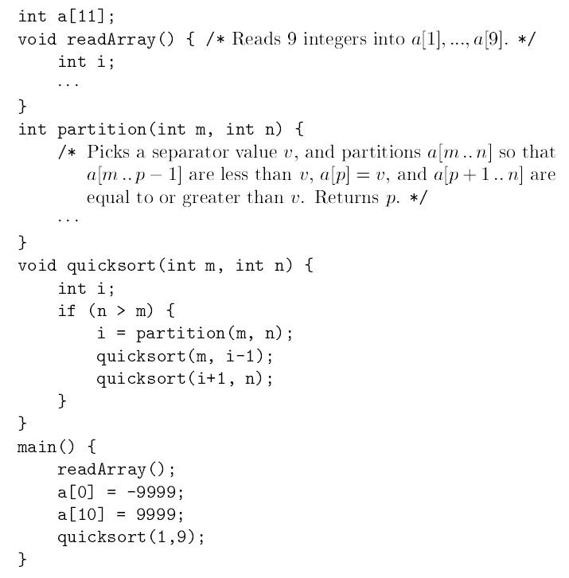
Sketch of a quicksort program

Slide 14
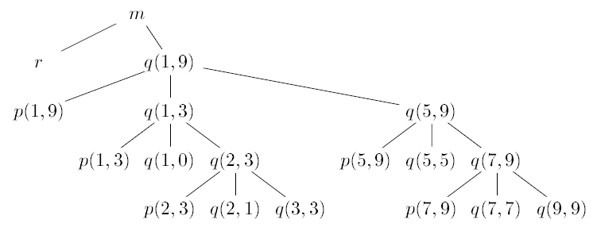
Activation tree representing calls during an execution of quicksort

Slide 15
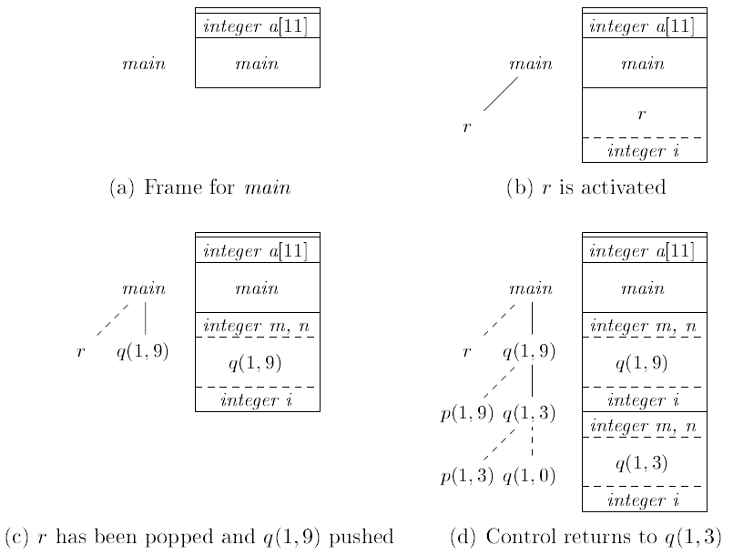
Downward-growing stack of activation records

Slide 16
Calling sequence
Procedure calls are implemented by what are known as calling sequences, which consists of code that allocates an activation record on the stack and enters information into its fields.
The caller evaluates the actual parameters and push the actuals on the stack
The caller saves return address and the old value of top_sp into the callee’s activation record.
The caller then increments top_sp to the position after the caller's local data and temporaries and the callee's parameters and status fields.
The callee saves registers and other status information
The callee initializes local variables & begin execution.

Slide 17
Return sequence
A return sequence is similar code to restore the state of the machine so the calling procedure can continue its execution after the call.
The callee places a return value next to the activation record of the caller.
Using information in the machine-status field, the callee restores top_sp and other registers, and then branches to the return address that the caller placed in the status field.
The caller copies the return value to its activation record.

Slide 18
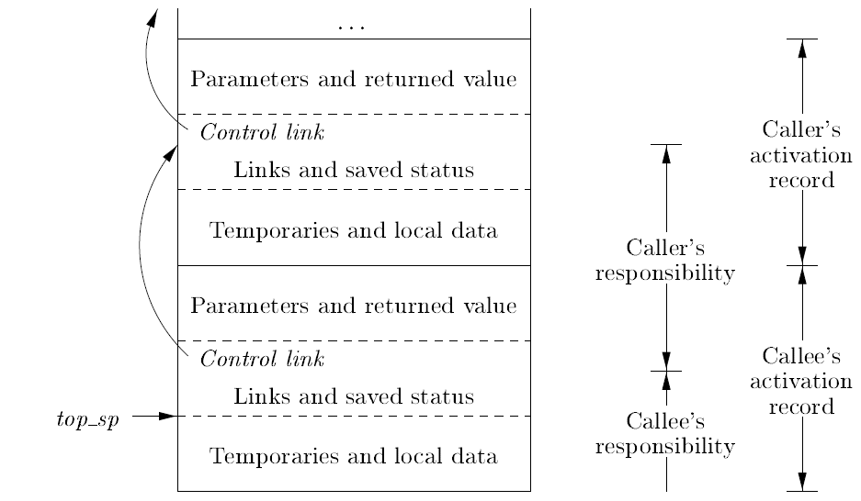
Division of tasks between caller and callee

Slide 19
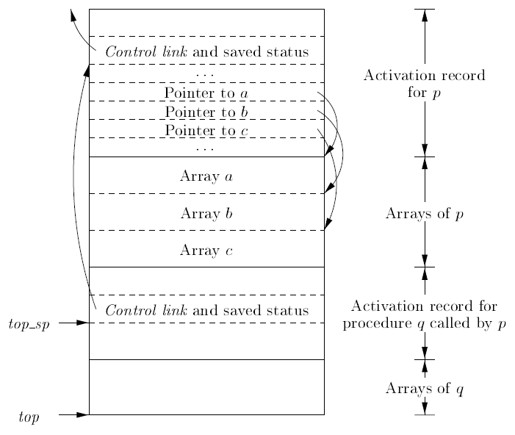
Variable-Length Data on the Stack
run-time memory-management system must deal frequently with the allocation of space for objects the sizes of which are not known at compile time, but which are local to a procedure and thus may be allocated on the stack
The storage for these arrays is not part of the activation record for p.
A pointer to the beginning of each array appears in the activation record itself

Slide 20
Access to non-local data
Nonlocal variables in C (without nested procedures):
Still have nested scopes (blocks).
Solution:
All data declared outside procedures are static.
Other names must be at the activation record at the top of the stack which can be accessed from top_sp.
Treat a block as a parameter-less procedure
Allocates space for all blocks in a procedure.

Slide 21
Access to non-local variables
If p is nested immediately within q in the source text, then the access link in an activation record for p points to the access link in the record for the most recent activation of q.
A procedure p at nesting depth n_p accesses a non-local a at nesting depth n_a: (1) following n_p – n_a links and (2) using the relative offset in the activation record.

Slide 22
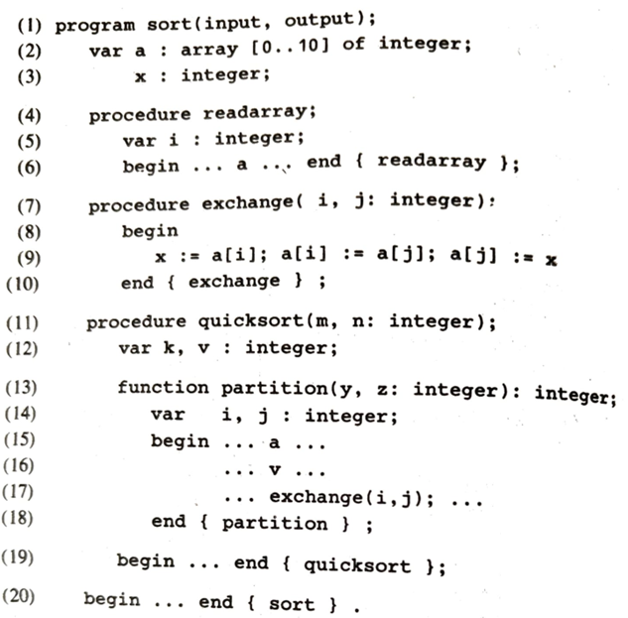
Pascal Program with nested procedure

Slide 23
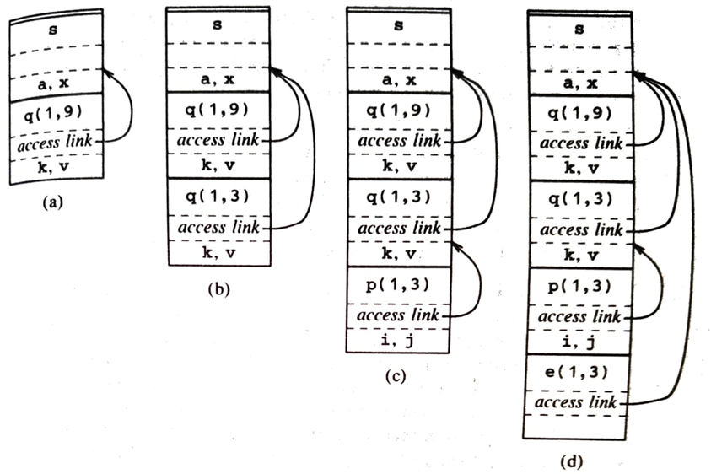
Access Links for finding storage

Slide 24
The code for setting up the access link in the called procedure depends on whether or not the called procedure p is nested within the caller q
Procedure p is at a higher nesting depth than q. Then p must be defined immediately within q, or the call by q would not be at a position that is within the scope of the procedure name p. Thus, the nesting depth of p is exactly one greater than that of q, and the access link from p must lead to q. It is a simple matter for the calling sequence to include a step that places in the access link for p a pointer to the activation record of q.
Examples include the call of quicksort by sort to set up Fig. (a), and the call of partition by quicksort to create Fig. (c).
The nesting depth np of p is less than or equal to the nesting depth nq of q. In order for the call within q to be in the scope of name p, procedure q must be nested within some procedure r, while p is a procedure defined immediately within r. The top activation record for r can therefore be found by following the chain of access links, starting in the activation record for q, for nq - np + 1 hops. Then, the access link for p must go to this activation of r. This case includes recursive calls, where p = q. In that case, the chain of access links is followed for one hop, and the access links for p and q are the same. An example is the call of quicksort(1; 3) by quicksort(1; 9) to set up Fig. (b). It also includes the case of mutually recursive calls, where two or more procedures are defined within a common parent.
Notes:
For an example of case (3), notice how we go from Fig. 7.11(c) to Fig. 7.11(d). The nesting depth 2 of the called function exchange is one less than the depth 3 of the calling function partition. Thus, we start at the activation record for partition and follow 3􀀀2+1 = 2 access links, which takes us from partition's activation record to that of quicksort(1; 3) to that of sort. The access link for exchange therefore goes to the activation record for sort, as we see in Fig. 7.11(d).

Slide 25
Parameter Passing
The method to associate actual parameters with formal parameters.
The parameter passing method will effect the code generated.

Slide 26
Techniques
Call by value
Call by reference
Call by copy-restore
Call by name

Slide 27
Call by value
The actual parameters are evaluated and their r-values are passed to the called procedure.
Implementation:
a formal parameter is treated like a local name, so the storage for the formals is in the activation record of the called procedure.
The caller evaluates the actual parameters and places their r-values in the storage for the formals.

Slide 28
Example – C & Pascal
Swap(int a, int b)
{ int temp;
temp = a; a = b; b = temp;
}
Void main()
{int a = 1, b = 2;
Swap(a, b); printf(“%d \t %d”, a, b);
}

Slide 29
Call by reference
Referred as call-by address or call-by-location.
The caller passes to the called procedure a pointer to the storage address of each actual parameter.
Actual parameter must have an address -- only variables make sense, an expression will not

Slide 30
Example C++
Swap(int * a, int * b)
{ int temp;
temp = *a; *a = *b; *b = temp;
}
void main()
{
int a = 1, b = 2;
Swap(&a, &b); printf(“%d \t %d”, a, b);
}

Slide 31
Call by Copy-Restore
A hybrid between call-by-value and call-by-reference.
The actual parameters are evaluated and its r-values are passed to the called procedure as in call-by-value.
When the control returns, the r-value of the formal parameters are copied back into the l-value of the actuals. Only actuals having l-values are copied.

Slide 32
Example
Swap(i, a[i]) works correctly using copy-restore
Location of a[i] is computed and preserved by the calling program before initiating the call
Used by Fortran

Slide 33
Call by name
Defined by the copy-rule of Algol
Procedure is considered as if it were a macro. The actual parameters are literally substituted with the formal as a macro-expansion.
Local names of called procedures are kept distinct. May be renamed.
Actual parameters are surrounded by parentheses to preserve integrity if necessary

Slide 34
Example
x : = f(A) + f(B)
A , B are expressions
Substitution of expressions A and B in the formal parameter leads to call by name

Slide 35
Summary
Run-time storage management
Static, Stack, Heap allocation
Parameter Passing techniques

